Slide 1
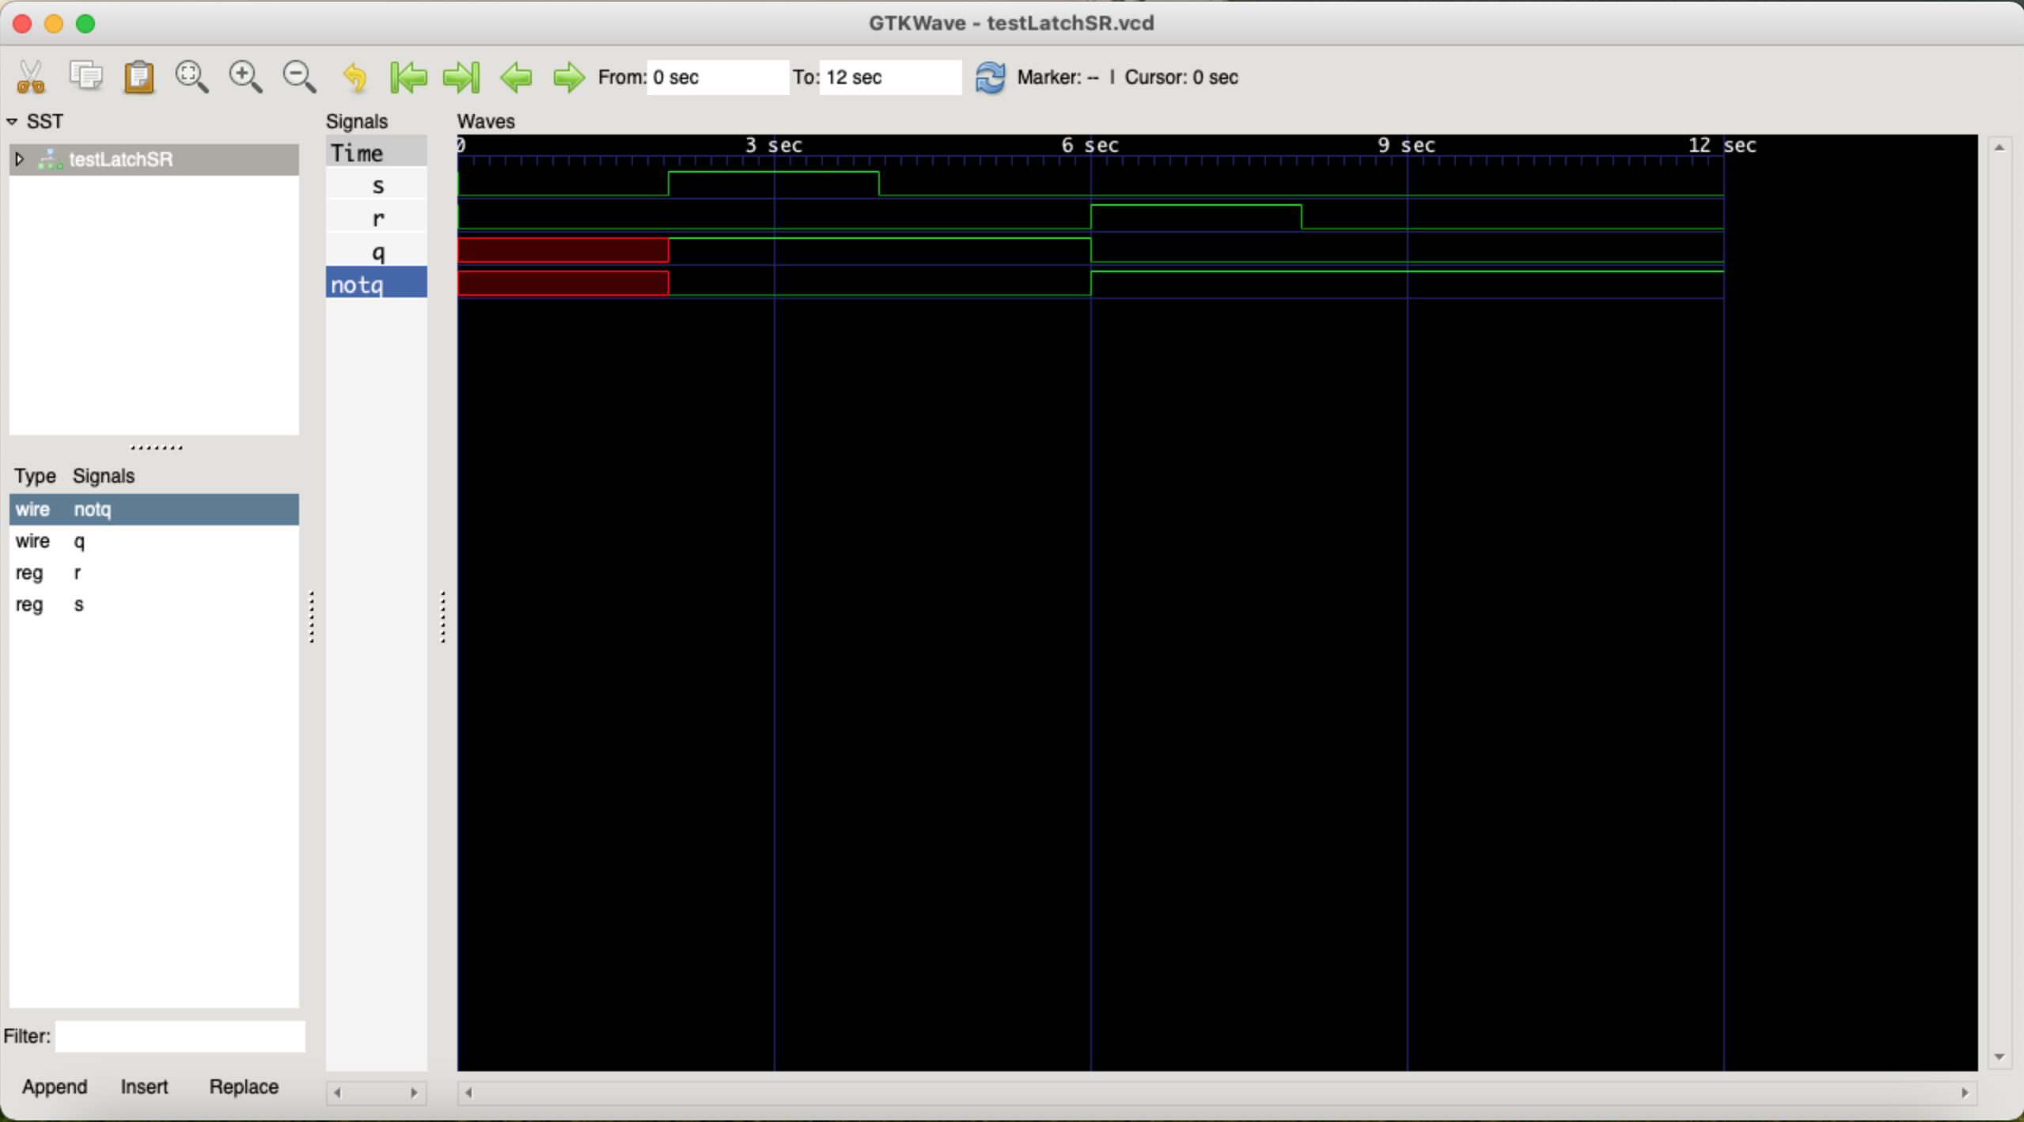
LatchSR

Slide 2
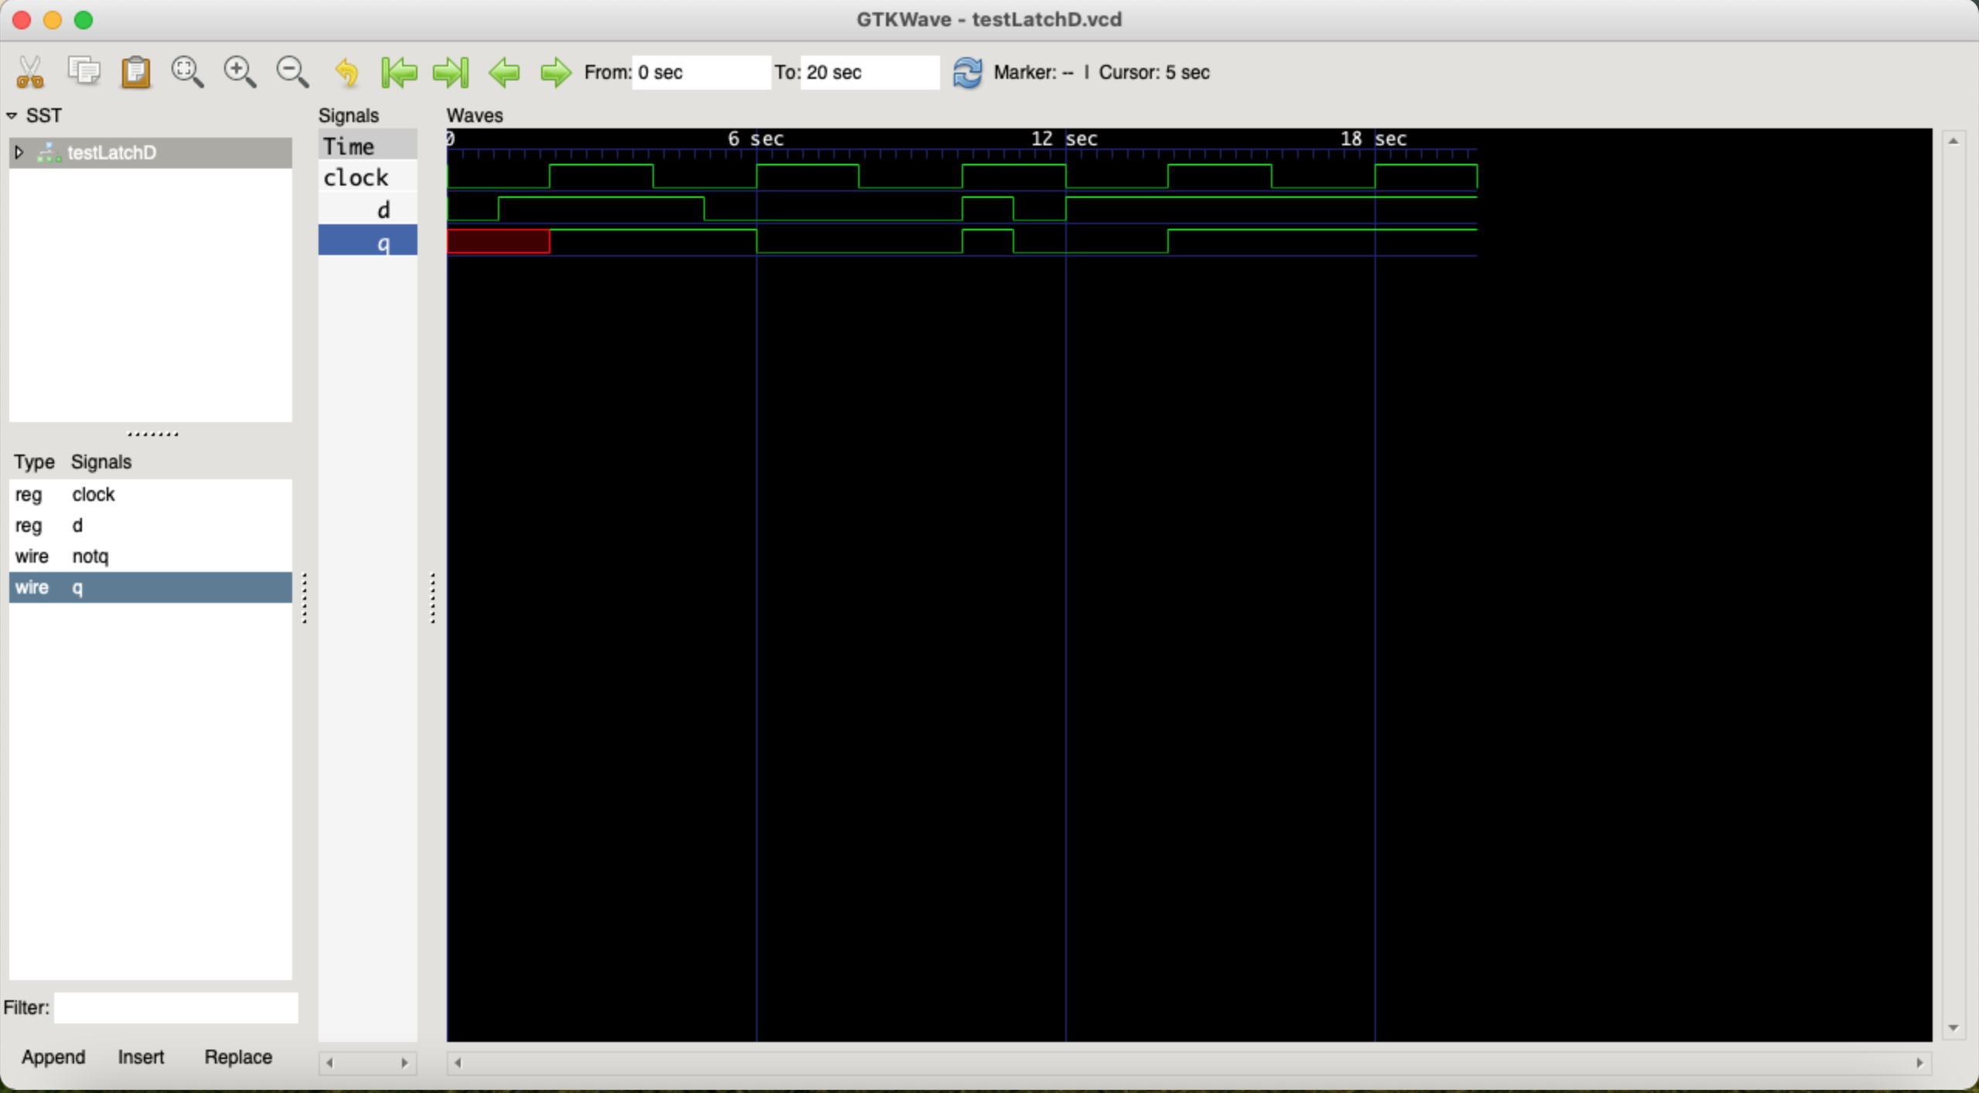
LatchD

Slide 3
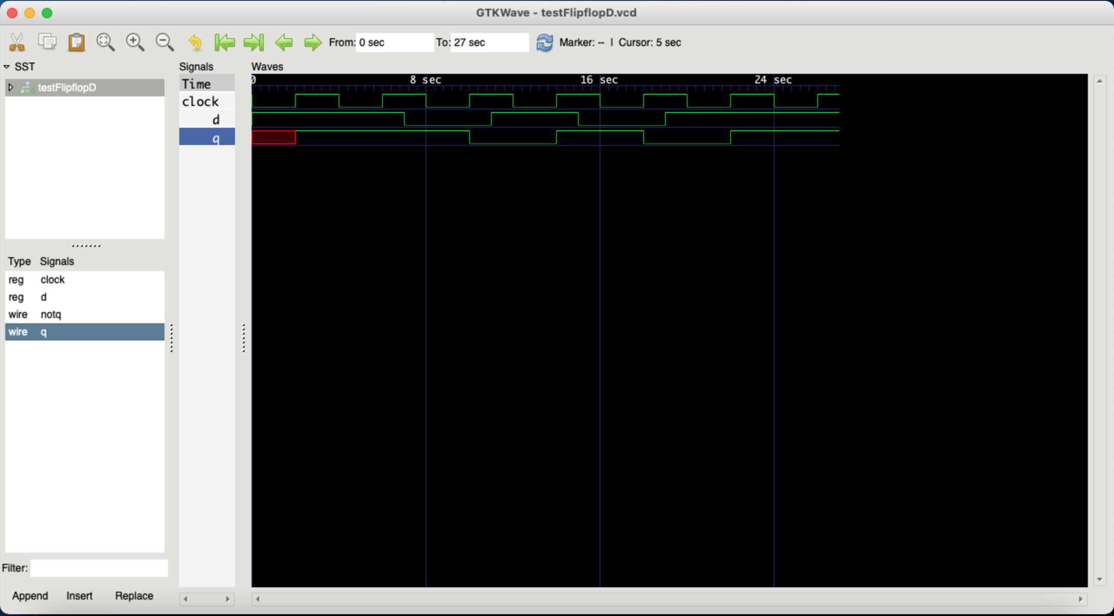
FlipFlopD

Slide 4
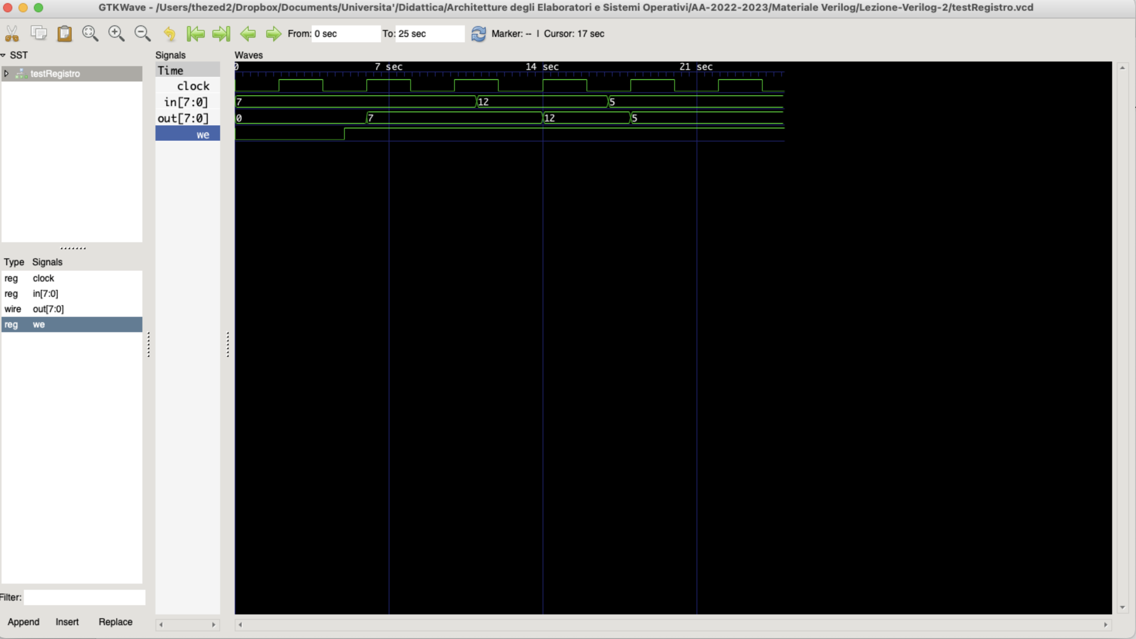
Registro (8 bit behavioural)

Slide 5
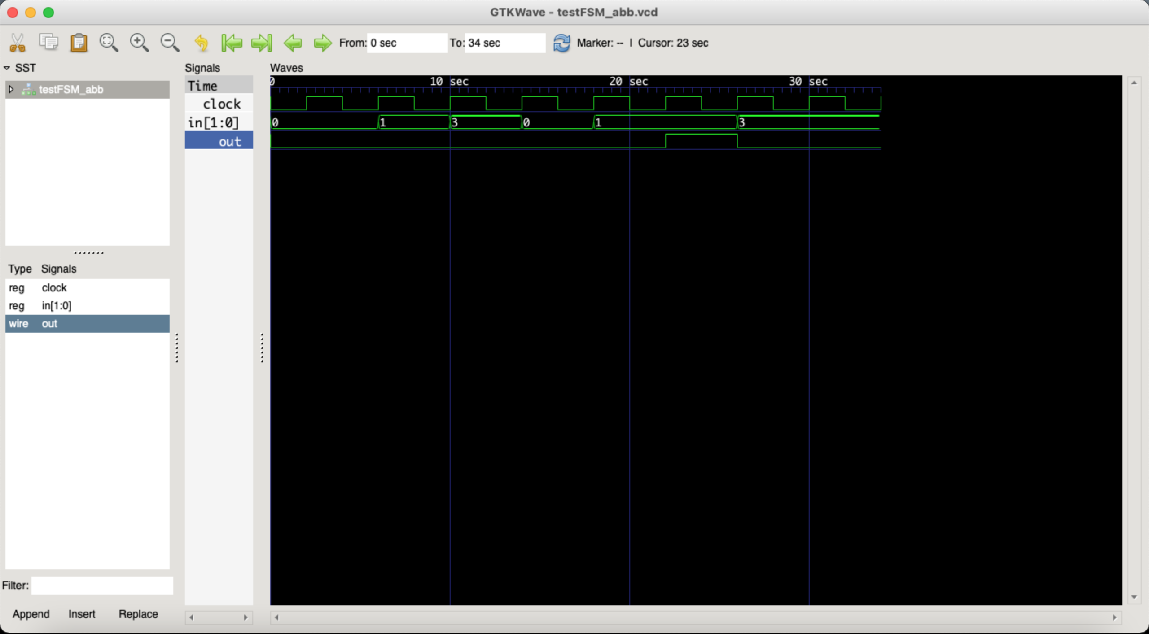
Riconoscitore “abb” (Mealy structural)

Slide 6

Riconoscitore “abb” (Mealy behavioural)

Slide 7
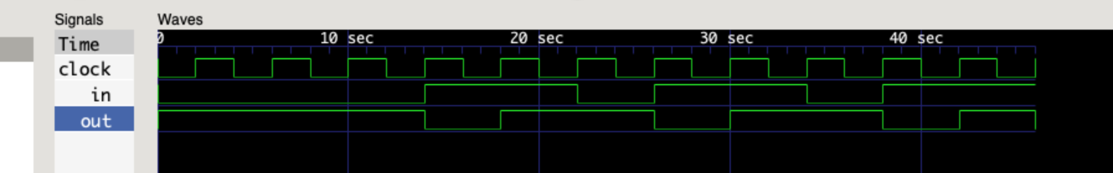
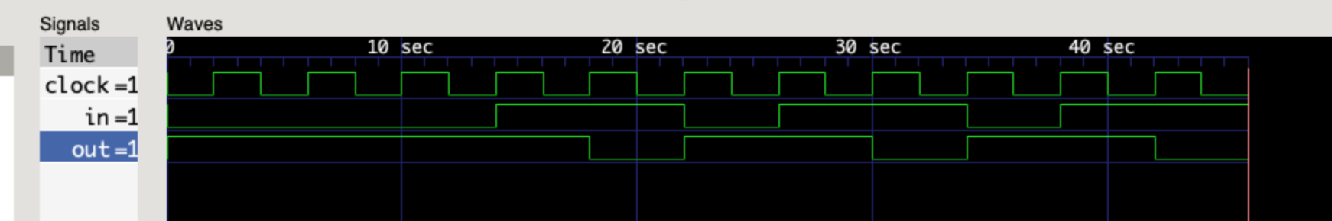
Parity (Mealy and Moore)
Mealy
Moore

Slide 8
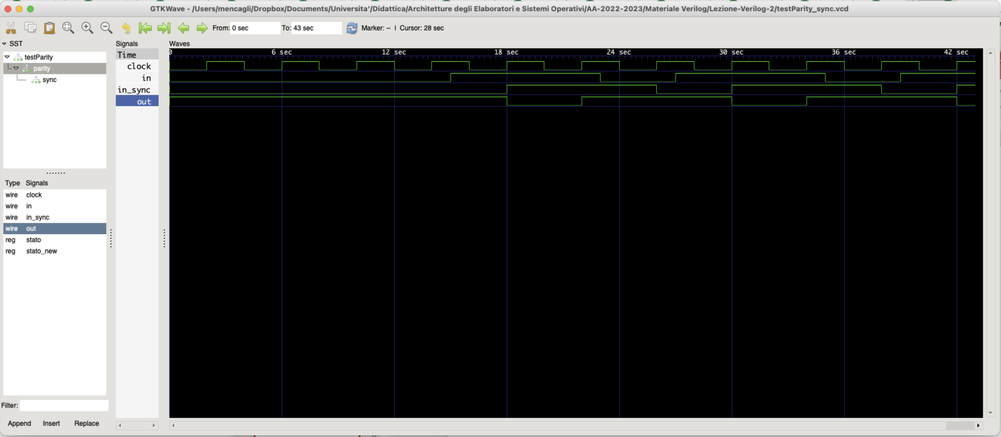
Parity (Mealy with Synchronizer)

